Slide 1

Capstone Project 2 –Credit Score Classification
Made by Saransh Shukla
Batch: DST 20823
Submitted to Mr. Kevin Shah

Slide 2
Problem statement
You are working as a data scientist in a global finance company. Over the years, the company has collected basic bank details and gathered a lot of credit-related information. The management wants to build an intelligent system to segregate the people into credit score brackets to reduce the manual efforts.

Slide 3
Different Approaches Considered
Intuitive K-Nearest Neighbors (KNN): Given the straightforward nature of the dataset, we considered employing KNN for its intuitive method of categorizing instances based on proximity, facilitating easy comprehension.
Versatile Support Vector Machine (SVM): Examined SVM as a versatile choice due to its proficiency in handling intricate relationships within the data, contemplating its efficacy in accurately classifying instances in the context of predicting aortic heart disease.
Insightful Decision Trees for Transparency: Contemplated utilizing decision trees to ensure transparency in the decision-making process, providing a clear insight into how different features contribute to the classification.
Probabilistic Naive Bayes: Evaluated Naive Bayes for its probabilistic approach, foreseeing its potential in handling the dataset's simplicity while establishing a reliable foundation for probability-based classification.
Simplicity in Logistic Regression: Explored Logistic Regression as a straightforward method, considering its simplicity and interpretability for binary classification tasks, aligning with the project's emphasis on predicting aortic heart disease.
Random Forest for Ensemble Learning: Deliberated the implementation of Random Forest for its capability in ensemble learning, contemplating the aggregation of decision trees to enhance predictive performance and robustness.
Voting Classifier for Model Aggregation: Considered a Voting Classifier to amalgamate predictions from multiple models, envisioning its potential to enhance overall accuracy by leveraging diverse algorithms for predicting aortic heart disease.

Slide 4
Approach which I Used
K-Nearest Neighbors (KNN): Chose KNN for its simplicity and effectiveness in capturing local patterns. Given the straightforward nature of the dataset, KNN's proximity-based approach aligns well with the project's objectives. It excels in scenarios where instances with similar features tend to have the same output, making it suitable for credit score classification.
Decision Trees: Implemented decision trees to ensure transparency in the decision-making process. The interpretability of decision trees is crucial for gaining insights into the key features contributing to predictions. Decision trees are effective in capturing non-linear relationships within the data, making them valuable for credit scoring where intricate patterns may exist.
Random Forest: Deliberated the use of Random Forest for its ensemble learning capability. Contemplated the aggregation of decision trees to enhance predictive performance and robustness. While the dataset is simple, the ensemble approach of Random Forest can capture more complex relationships, providing a boost in accuracy for credit score classification.
Naive Bayes: Utilized Naive Bayes for its probabilistic approach, suitable for handling the simplicity of the dataset. The model's efficiency in high-dimensional spaces and assumption of feature independence complement the project's requirements. Naive Bayes is known for its simplicity and quick training times, making it suitable for large datasets.
Excluded Models:
Support Vector Machine (SVM): Dropped SVM due to the large dataset and overlapping relations of the target variable. SVMs can be computationally expensive, and their effectiveness diminishes with large datasets. In cases where the relationship between features and the target variable is overlapping, SVM may not provide significant advantages.
Voting Classifier: Omitted Voting Classifier as combining models didn't offer substantial advantages for this specific project. The ensemble approach didn't significantly enhance predictive performance, and the increased training time was not justified compared to the individual models.
Logistic Regression: Excluded Logistic Regression due to the target variable including three outputs. Logistic Regression is well-suited for binary classification tasks, and introducing three outputs might complicate the model's understanding and classification, leading to potential challenges in performance.

Slide 5
Details of Project Execution:
Data Collection and Cleaning:
Gathered the initial dataset from Kaggle, ensuring a diverse representation of credit-related features.
Conducted thorough data cleaning, addressing a substantial number of null values within the dataset.
Utilized the mode for categorical features to impute missing values and employed a combination of dropping rows and forward/backward fills for numerical features.
Ensured data integrity by converting columns to appropriate data types, such as transforming object types to float where necessary.
Further enhanced dataset cleanliness by replacing remaining null values with the median.
Streamlined the dataset by removing redundant features that were deemed irrelevant for the subsequent machine learning models.
Exploratory Data Analysis (EDA):
Uncovered class imbalance during EDA and strategically planned to mitigate it through oversampling techniques during the feature selection phase.
Observed non-Gaussian distribution patterns in many features, implying potential challenges for certain statistical modeling techniques.
Identified overlapping instance zones within the dataset, leading to the informed decision to exclude Support Vector Machine (SVM) due to its limitations in handling such scenarios.
Data Preprocessing:
Executed a comprehensive data preprocessing pipeline, applying LabelEncoder to the target variable to convert categorical labels into a numerical format.
Ensured uniformity in numerical feature scales by standardizing them using StandardScaler.
Employed one-hot encoding (pd.get_dummies) for categorical variables, enhancing the model's ability to interpret these features effectively.

Slide 6
Feature Selection:
Employed statistical significance testing, specifically using f_classif as a parameter in SelectKBest, to identify the most influential features.
Selected the top 7 features based on their impact on the target variable, effectively reducing dimensionality while retaining critical information.
Oversampling:
Addressed the class imbalance observed during EDA by incorporating Synthetic Minority Over-sampling Technique (SMOTE), ensuring a balanced representation of classes in the dataset.
Dataset Splitting:
Segregated the dataset into training (80%) and testing (20%) subsets, adhering to standard practices for model evaluation.
Model Training:
Trained multiple machine learning models, including K-Nearest Neighbors (KNN), Decision Tree, Random Forest, and Naive Bayes, using the preprocessed and balanced dataset.
Observed promising results during training, with Random Forest demonstrating the highest accuracy among the models.
Model Evaluation:
Rigorously evaluated model performance on the validation set, focusing on accuracy, precision, recall, and F1 score.
Random Forest exhibited robustness in retaining its performance on the test dataset, showcasing its suitability for the credit score classification task.
Hyperparameter Tuning:
Experimented with hyperparameter tuning to optimize model performance.
Despite the attempt, the tuned models did not exhibit a significant improvement over the baseline, leading to the decision to retain the original Random Forest model.
Performance Metrics:
Quantified the model's effectiveness using key performance metrics.
Random Forest achieved an impressive F1 score of 81.34% and an accuracy of 81.46%, reinforcing its standing as the most effective model for credit score prediction.

Slide 7

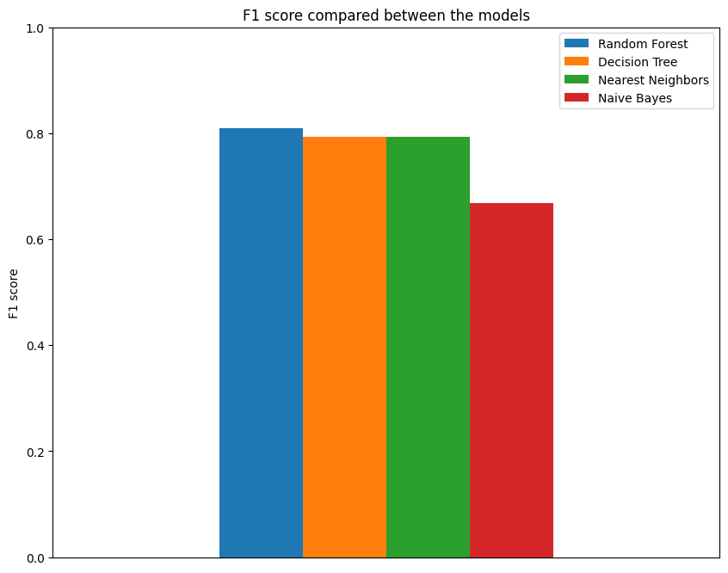
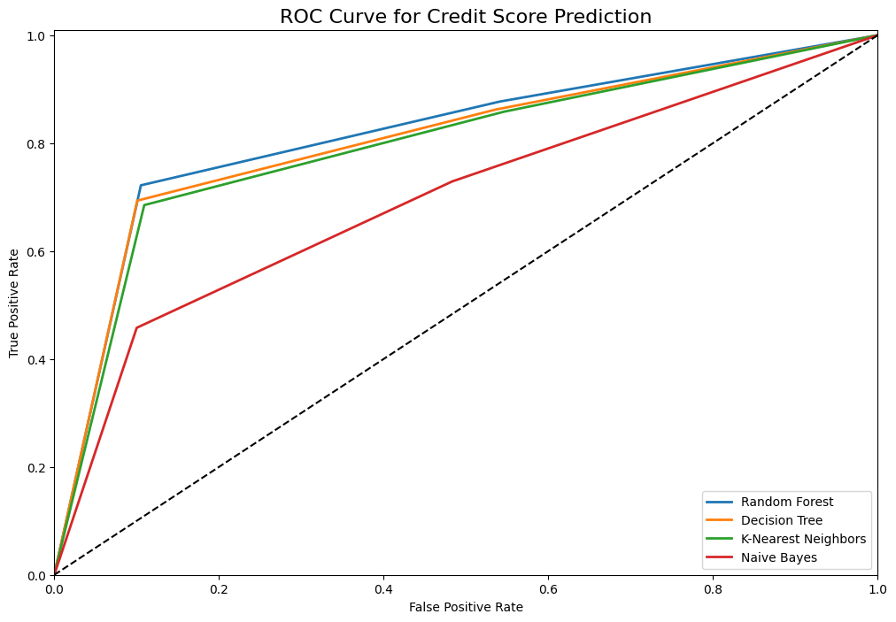
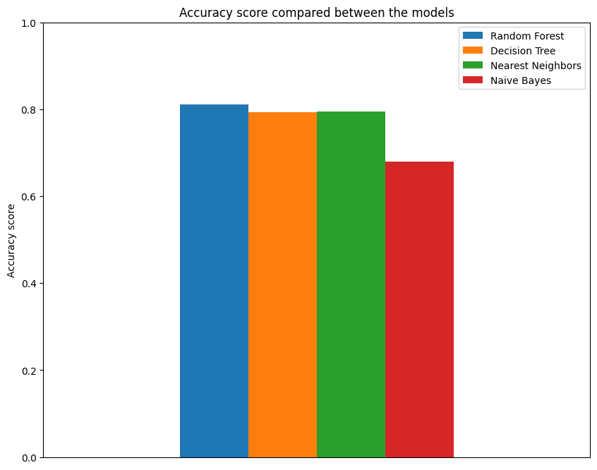
Results

Slide 8
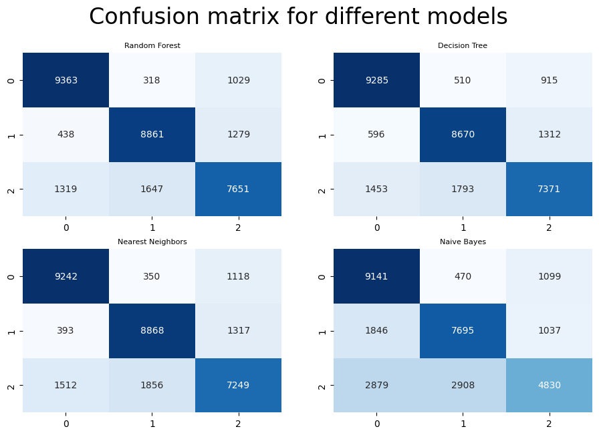
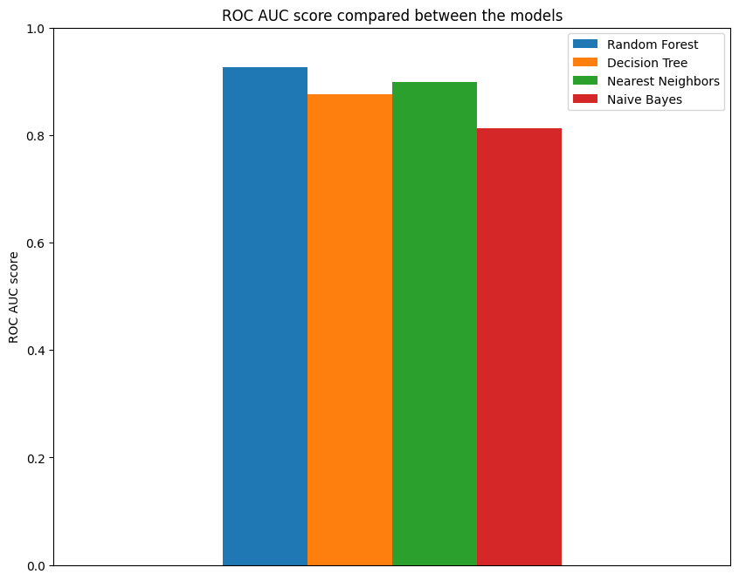

Slide 9
Thank You

